Slide 1
All About Me
An interactive presentation by Kelly Feeney

Slide 2
Table of Contents
Meet My Family
A Few of My Favorite Things
My Personality
My Past
My Present
My Future

Slide 3
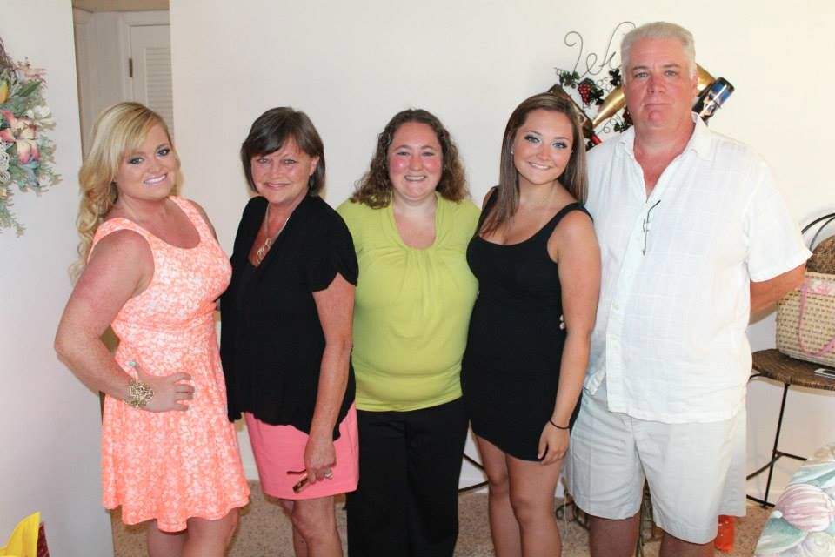
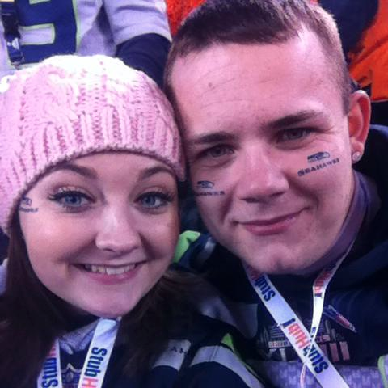
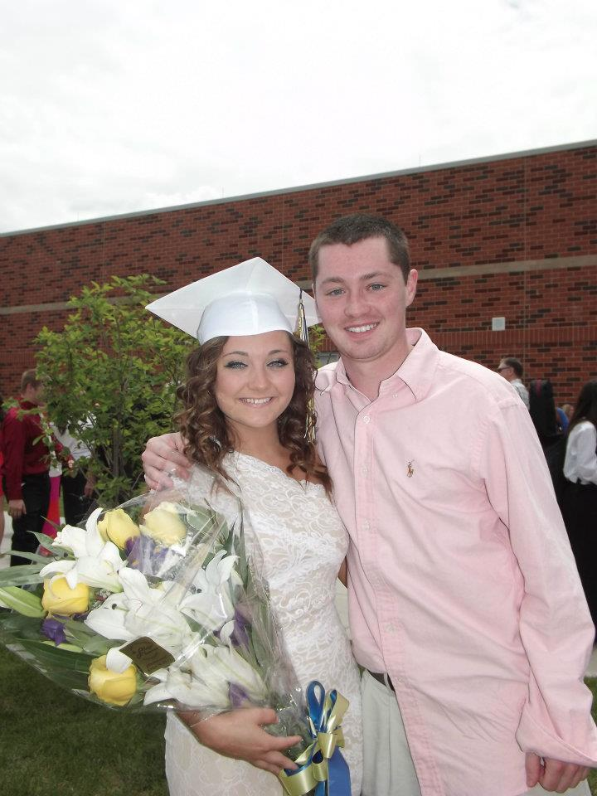
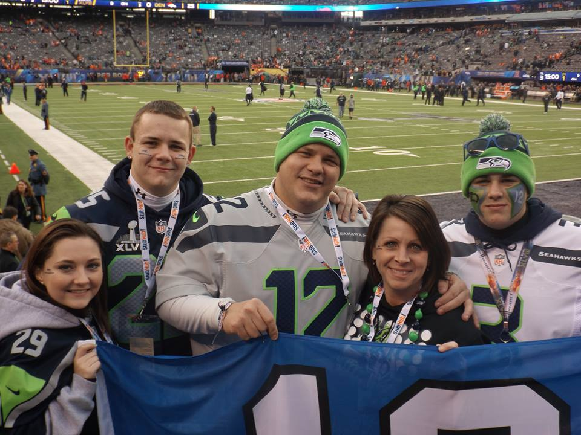
Meet My Family!

Slide 4
Biological
Dad
Colleen
Mom
Meg
Mike

Slide 5
“Family By Choice”
Christopher
Chris
Chuckie
Clayton
Heather

Slide 6
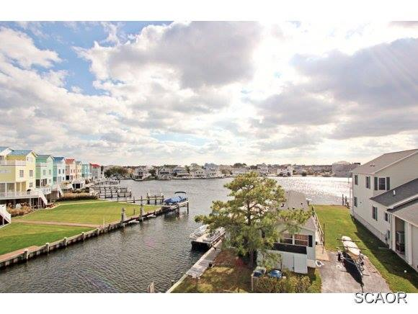
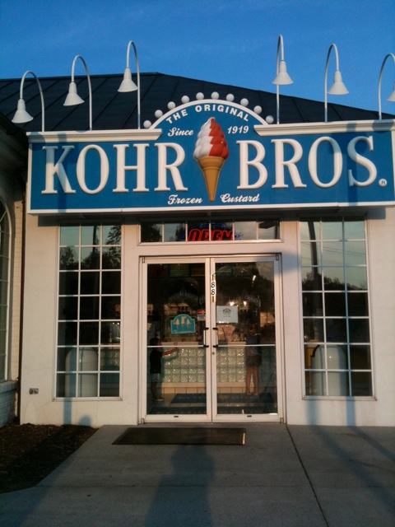
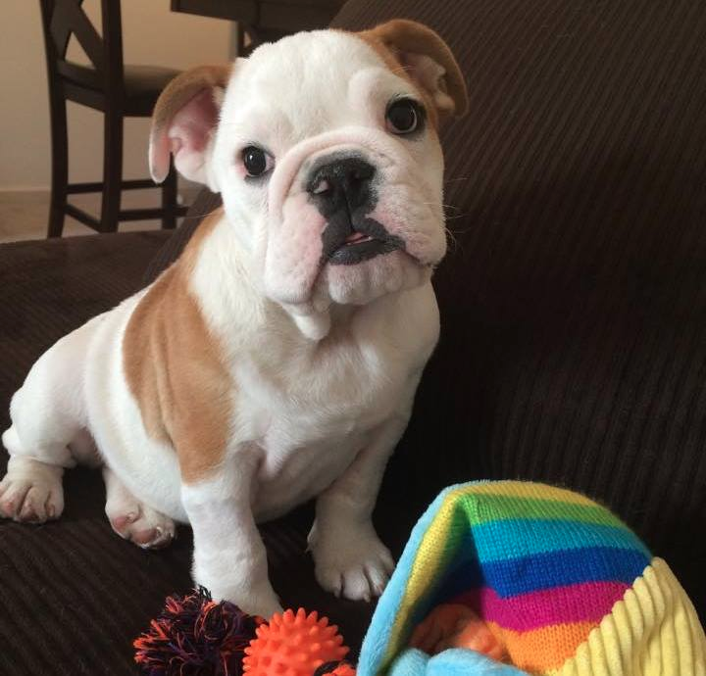
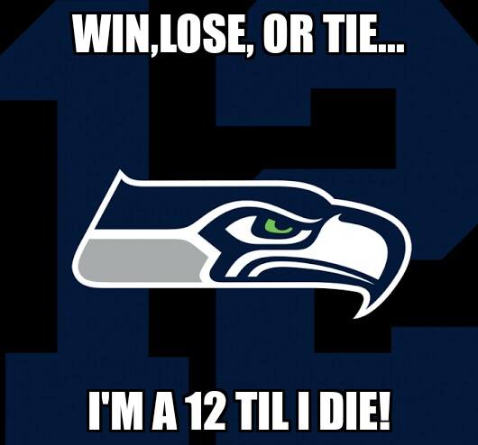
A Few OF My Favorite Things
Fenwick Island, Delaware
Harper Rose

Slide 7
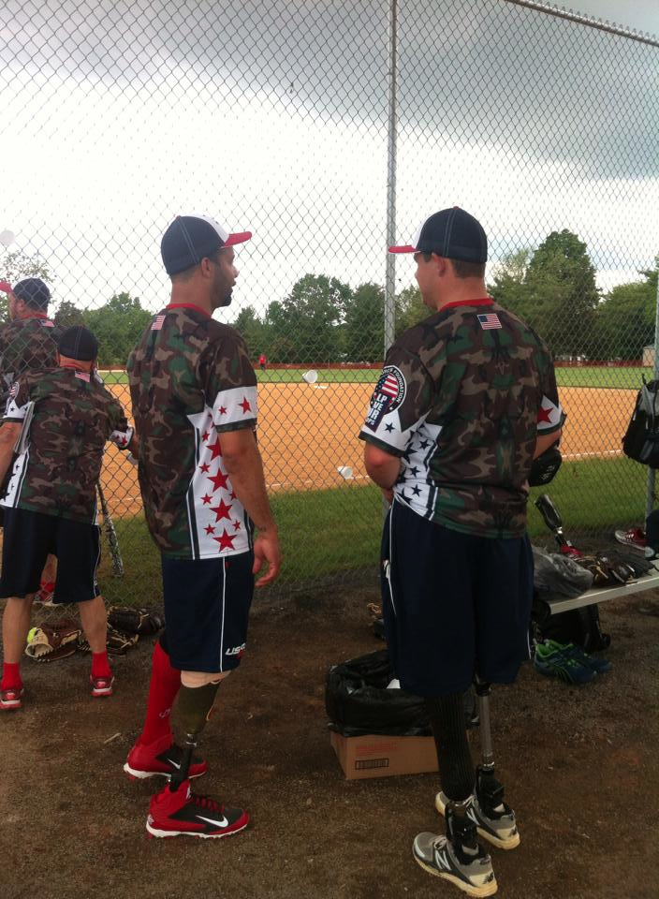
My Personality
Outgoing
Talkative
Shopaholic
Shoe Lover
Animal Lover
Very into Sports: I love the Seattle Seahawks and had the privilege of traveling the East Coast with the Wounded Warrior Amputee Softball Team.

Slide 8
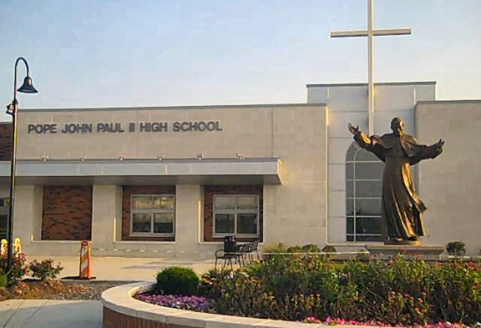
My Past
Born August 2nd, 1993 in Audubon PA
Youngest of 4 children
Attended Elementary school at St. Teresa of Avila Catholic School
Attended Freshman and Sophomore year at Villa Maria Academy for Girls in Malvern, PA.
Attended Junior and Senior year at Pope John Paul II Catholic High School in Royersford, PA.
Started Nursing School at Catholic University in DC in 2012, transferred to De Sales in 2014 for Early Childhood Education

Slide 9
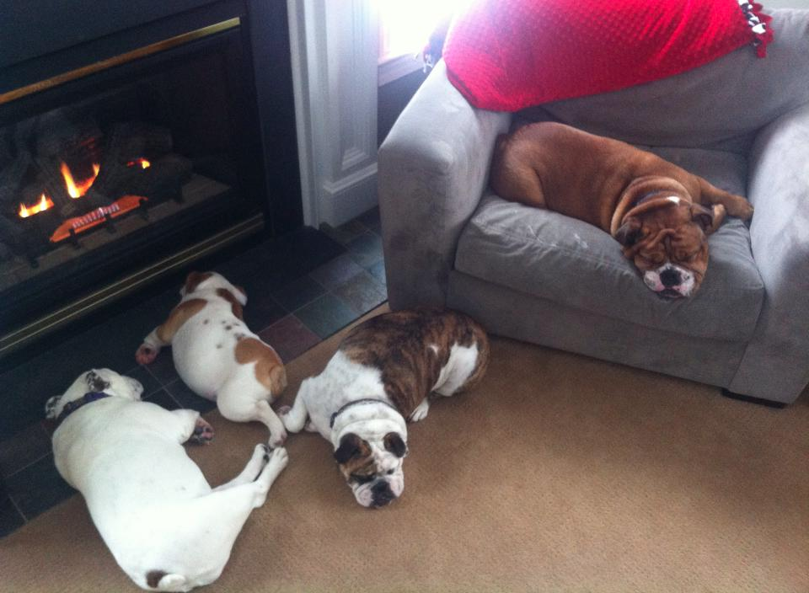
My Present
Sophomore Early Childhood Education Major
Lives off-campus in an apartment
Spends the summer in Fenwick Island, Delaware
Proud owner of 4 English Bulldogs

Slide 10
My Future
Kindergarten or 2nd Grade Teacher
House with a lot of land
Range Rover SUV
English Mastiff dog and English Bulldogs
Involved in the Wounded Warrior Project and Amputee Softball Team

